Slide 1
Ch-1
Basics of Network

Slide 2
Basic of network
A computer network is a group of computer systems and other computing hardware devices that are linked together through communication channels

Slide 3
Network concepts

Slide 4
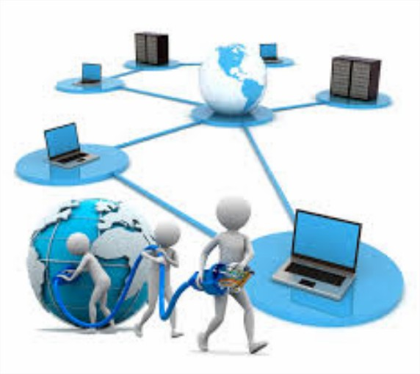
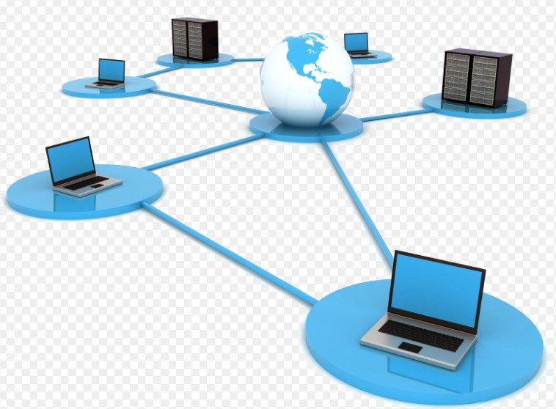
what is a Network?
A network, in computing, is a group of two or more devices.
A network is a collection of computers, servers, mainframes, network devices, peripherals, or other devices connected to one another to allow the sharing of data.
An excellent example of a network is the Internet, which connects millions of people all over the world.

Slide 5
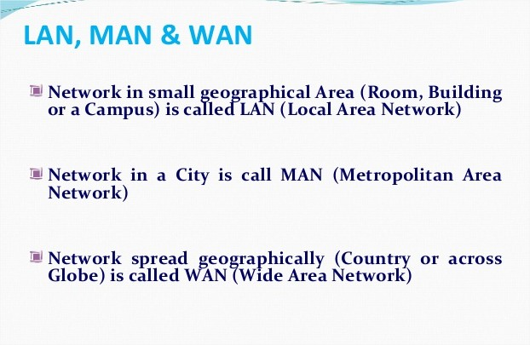

Slide 6
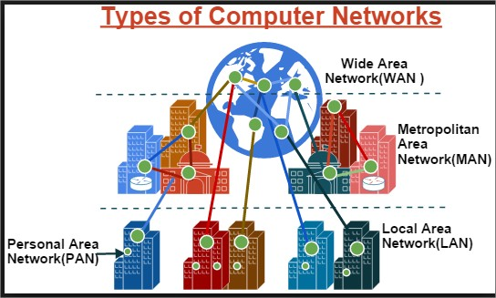
What are the different types of network technologies?
Personal Area Network (PAN) ...
Local Area Network (LAN) ...
Wireless Local Area Network (WLAN) ...
Campus Area Network (CAN) ...
Metropolitan Area Network (MAN) ...
Wide Area Network (WAN) ...
Storage-Area Network (SAN)

Slide 7
Use of network
Wired technologies.
Wireless technologies.
Exotic technologies-
Free company information from Companies House including registered office address, filing history, accounts, annual return,
Network interfaces.
Repeaters and hubs.
Bridges.
Switches.
Routers.

Slide 8
Network model

Slide 9
Network model
Network model
-peer – to – peer
a peer-to-peer (P2P) network is created when two or more PCs are connected and share resources without going through a separate server computer. A P2P network can be an ad hoc connection—a couple of computers connected via a Universal Serial Bus to transfer files.
-client – server
A computer network in which one centralized, powerful computer (called the server ) is a hub to which many less powerful personal computers or workstations (called clients ) are connected.

Slide 10
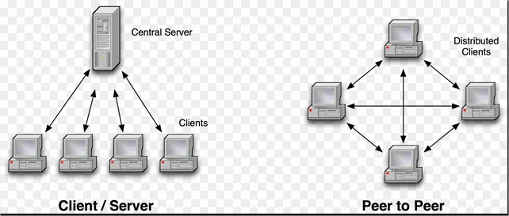
-peer – to – peer -client – server

Slide 11
Network Services

Slide 12
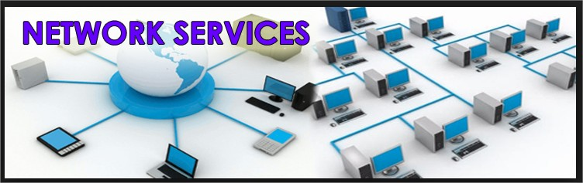
Network Services
- File service,
- Print service,
- Comm. service,
- Data base service,
- Security service,
- Application service

Slide 13
Network Access Methods

Slide 14
Network Access Methods
- csma / cd, csma / ca,
- Token passing
- Polling

Slide 15
CSMA/CD (Carrier Sense Multiple Access/Collision Detection)
every host has equal access to the wire and can place data on the wire when the wire is free from traffic.
CSMA/CA (Carrier Sense Multiple Access/Collision Avoidance)
In CSMA/CA, before a host sends real data on the wire it will “sense” the wire to check if the wire is free.

Slide 16
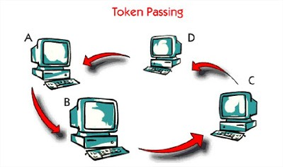
Token passing
On a local area network, token passing is a channel access method where a signal called a token is passed between nodes to authorize that node to communicate.
Polling is most often used in terms of input/output (I/O), and is also referred to as polled I/O or software-driven I/O.

Slide 17
Network Topologies

Slide 18
What is a topology ?
A network topology is the arrangement of a network, including its nodes and connecting lines.
There are two ways of defining network geometry:
the physical topology and
the logical (or signal) topology.

Slide 19
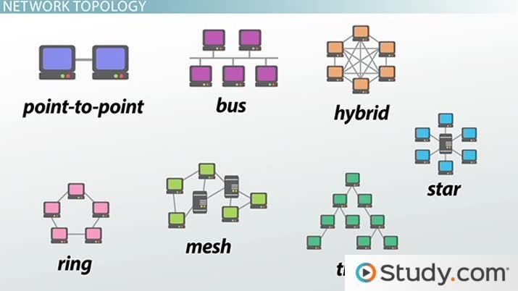

Slide 20
Bus topology uses one main cable to which all nodes are directly connected.
In star topology, each computer is connected to a central hub using a point-to-point connection.
In ring topology, the computers in the network are connected in a circular fashion, and the data travels in one direction.
Mesh topology nodes are connected to each other in a redundant fashion with multiple connections.
A tree network topology is the one in which there is a main functioning root node that is then connected to other servers via point to point topology in the levels of hierarchy.
A hybrid network topology is the kind of arranging work stations in such a way that it doesn’t resembles any of the basic network topologies like the star, bus or ring, etc.

Slide 21
Advanced Topologies Ethernet, CDDI, FDDI

Slide 22
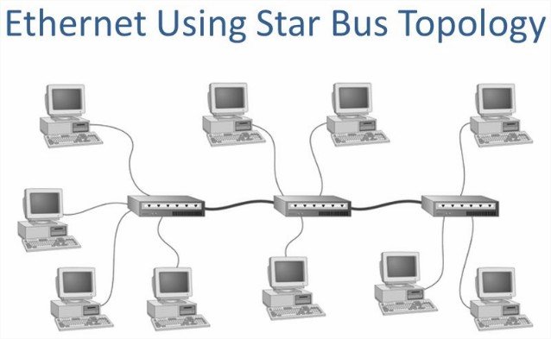
Ethernet networks topology
Ethernet is the most widely used network topology.
You can choose between bus and star topologies,
as well as coax, twisted-pair, or fibre optic cabling. And with the right connective equipment, multipleEthernet-based LANs can be linked together.
Ethernet is the traditional technology for connecting wired local area networks

Slide 23
Cddi topologies
CDDI is a Copper Data Distribution Interface (CDDI).
The logical topology used in CDDI is a ring-based token network.
a network technology capable of carrying data at 100 Mbps speed.

Slide 24
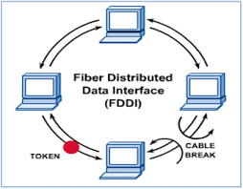
Fddi topologies
FDDI (Fiber Distributed Data Interface)
is a set of ANSI and ISO standards for data transmission on fiber optic lines in a local area network (LAN) that can extend in range up to 200 km (124 miles).
The FDDI protocol is based on the token ring protocol.

Slide 25
Communication Methods

Slide 26
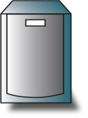
Unicast, Broadcast and Multicast
Key:
Unicast transfer
Broadcast transfer
Multicast transfer
Unicast
One-to-one
Destination – unique receiver host address
Broadcast
One-to-all
Destination – address of network
Multicast
One-to-many
Multicast group must be identified
Destination – address of group

Slide 27
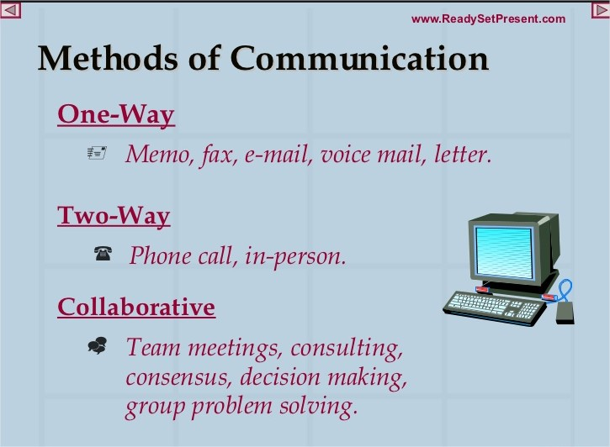

Slide 28


